Slide 1


GHOUSIA COLLEGE OF ENGINEERING
RAMANAGARA - 562159
A Project Presentation on
“UTILIZING IOT FOR SOLAR PANEL MONITORING”
Under the guidance of
Prof. MOHAMMED FAZALE ELAHI
Presenting By
JAZIB HASSAN MOHAMMAD FARMAN SAMEER
SYED NABIL UR RAHMAN
1GC20CS018
1GC20CS031
1GC20CS049
1GC20CS056

Slide 2
Contents
Introduction Literature Survey Objective of the Project Problem Definition Proposed System Existing System Methodology Architecture Diagram Applications
Advantages & Disadvantage Expected Outcomes References

Slide 3
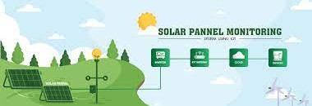
Introduction
Solar power plants need to be monitored for optimum power output. This helps retrieve efficient power output from power plants while monitoring for faulty solar panels.
Here we propose an automated IOT based solar power monitoring system that allows for automated solar power monitoring from anywhere over the internet
It constantly monitors the solar paneland transmits the power output to IOT system over the internet.

Slide 4
LITERATURE SURVEY
Vishal Singh et.al., “IoT based solar panel monitoring system”
Aimed to Optimize Power Output.
Performance of panel is inherently tied to the energy received by solar cell. Provides information about the load being powered by the panels.
Balakrishnan D et.al., “IoT based system for fault detection and diagnosis in solar pv panels”
IoT based system designed for detection and diagnosis of pv panel. Primary objective is to enhance the performance.
The system has ability to identify faults in real time.

Slide 5
T Asha Rakshana et.al., “IoT based solar panel fault monitoring and control by using wi-fi modem”
Increase production by rectifying the issue.
Integrating a smart home network within the Solar System.
Detection the fault occur through the Light Dependent Resistor(LDR).
Preethi Sekar et.al., “IoT based Solar Energy Monitoring”
Enhancing the Efficiency by by incorporation of solar tracker. Utilizes the Maximum Power Point Tracking Mechanism (MPPT).
Track’s the Sun position and direction to optimize Sun Exposure on it’s surface.

Slide 6


Objective of the Project
Real-Time Data Collection
Examine Data for Overall Energy Production
Aiding in pinpoint fault Detection & Monitoring Provides User-Friendly Interface

Slide 7
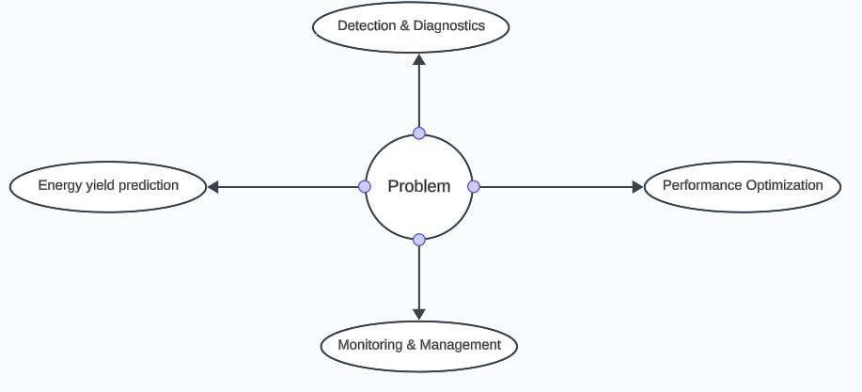
Problem Definition

Slide 8

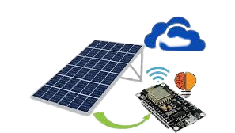
Proposed System
Real time data collection. Data Transmission Analytics & Monitoring Energy Efficiency

Slide 9
Existing System
Transition to Renewables: As non-renewable sources decline, there's a pronounced shift towards harnessing renewable resources.
Solar Technology Advantage: Solar energy technology efficiently captures and stores energy, presenting a reliable and sustainable power solution.
Enhancing Solar Efficiency: Integration of solar trackers with MPPT optimizes energy generation by maximizing sun exposure.
Intelligent Issue Detection: Utilizing an IoT-based solution equipped with wireless sensors to identify and address problems in solar panels, ensuring improved performance.
Addressing Panel Challenges: The system focuses on resolving issues such as shading, soiling, degradation, and electrical malfunctions, enhancing the overall reliability of solar panels.

Slide 10
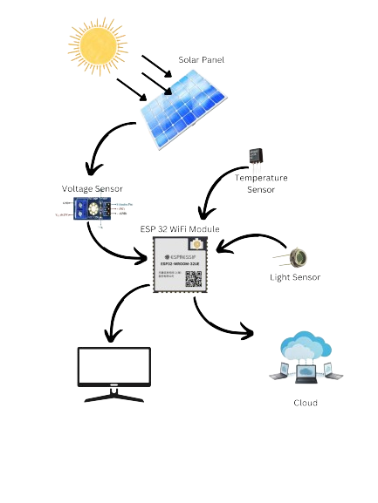
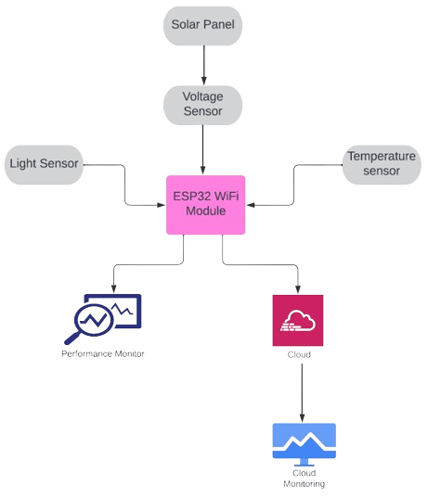
Methodology
Fig. Graphical Representation of System
Fig. Block Diagram of the system

Slide 11
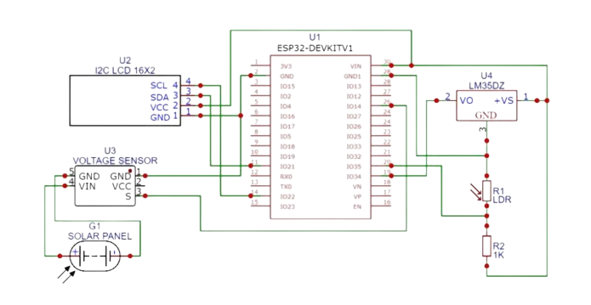
Architecture Diagram
Solar Panel
ESP32 Wi-fi Module Voltage Sensor Module LDR Light Sensor
16x2 I2C LCD Display Resistor 2.2k
Zero PCB/ Vero Board LM35 Temperature Sensor

Slide 12
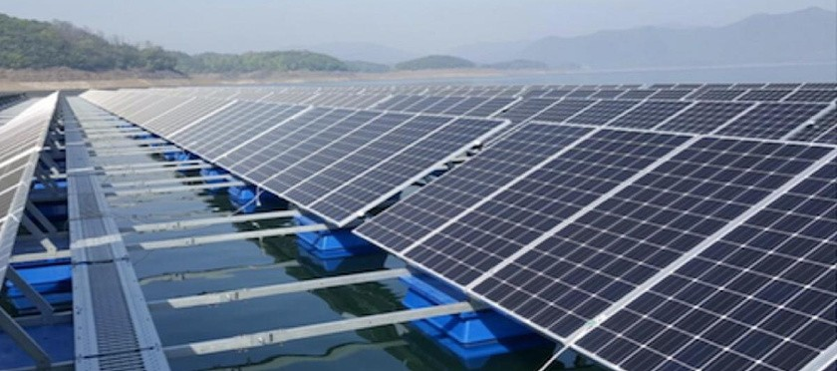
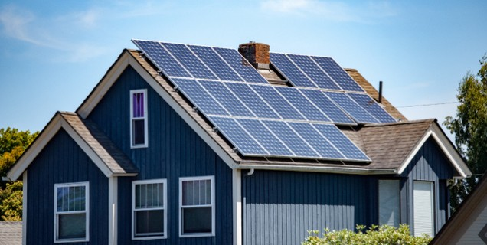
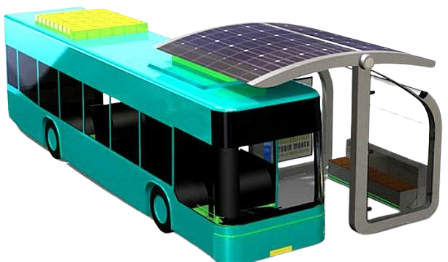
Applications
Solar Farm’s
Smart Home Integration
Solar Powered Transportation

Slide 13
Advantages & Disadvantages
Advantages
Disadvantages
Immediate data Access Remote Management Efficient Maintenance Energy Optimization Data Analytics
Integration With other System Scalability
Security Concerns Integration Issues High Initial Cost Data Overload
Dependency on Connectivity Skill Requirement
Lack of Standards

Slide 14
Expected Outcomes
The system showcases the solar voltage produced by the solar panel, and this information is displayed on the LCD screen.
The displayed data is derived from measurements taken by the sensors, ensuring accuracy and real-time representation.
Concurrently, the system generates a graphical output on a cloud server, making the information accessible on a global scale.
Users have the capability to access this solar voltage data from any location, providing a convenient and remote overview.
The comprehensive presentation is facilitated through both the local LCD screen and the cloud- based interface, allowing users to monitor the solar voltage efficiently.

Slide 15
References
[1] Vishal Singh 1st, 2Dr. Devesh Katiyar 2nd, 3MR. GAURAV GOEL 3rd, 4rth Yogesh Dev Singh 4th 2021 “IOT BASED SOLAR POWER MONITORING SYSTEMJETIR September 2021, Volume 8, Issue 9.
[2] Balakrishnan D 1, Raja J 2, Manikandan Rajagopal3, Sudhakar K4 and Janani K 5 “IOT-BASED SYSTEM FOR FAULT DETECTION AND DIAGNOSIS IN SOLAR PV PANELS” Kalasalingam Academy of Research and Education, Anand Nagar, Krishnankoil-626126, Tamilnadu, India.
[3] T.Asha Rakshana 1st, R.Palselvam 2nd, S.Priya 3rd, K Genda Devi 4rth “IOT Based Solar Panel Fault Monitoring and Control By Using Wi-Fi Modem” SSRG_IJEEE)Volume 7 Issue 1 - January 2020.
[4] Preethi Sekar 1st, Priya Sabde 2nd, Ganesh Patil 3rd “IoT-based Solar Energy Monitoring “ (IRJET) Volume: 09 Issue: 06 | June 2022.
[5] P.Sampurna Lakshmi 1st, Dr.S. Sivagama Sundari 2nd, Dr. R. Manjula sri 3rd ” Solar Panel Fault Detection System using IoT” Eur. Chem. Bull. 2023, 12(Special Issue 7), 3199-3206.
[6] Kabalci, Ersan, Alper Gorgun, and Yasin Kabalci. "Layout and implementation of a renewable energy tracking device." power Engineering, energy and electric Drives (POWERING), 2013 Fourth worldwide conference on. IEEE, 2013.
[7] Bartolomeo. M. (2014), Internet of things; Science fiction or business fact. A Harvard Business Review of Analytic and also Services Report From the Haward, Tech. Rep.
[8] Adhya, S., Saha, D., Das, A., Jana, J., &Saha, H. (2016, January). An IOT based smart Solar panel Photovoltaic remote monitoring and control unit, In 2016 2nd international conference on control, instrumentation, energy & communication (CIEC) (pp. 432-436), IEEE.

Slide 16
Thank You

